Slide 1

Supervised by Dr. Hanaa Bayomi Ali T.A Heba Mahgoub
20196066 | Sohaila Mohamed El-Mesmary
20196071 | Lilian Nagy
20196049 | Mohamed Mahmoud
20196023 | Ziad Alaa
20196047 | Mohamed Essam
Graduation Project
Academic Year 2022-2023
Final Presentation

Slide 2
Introduction

Slide 3
A drastic increase can be seen in food waste. and this is considered a global problem, as there are millions of tons of food leftover from food businesses, this leftover is wasted and turned into garbage, and no one has benefit from it. As a result, there is a need to develop a solution that can reduce food wastage, contribute in providing food for the needy, and reduce the percentage of the hungry. We aim to help in solving this problem with a website that implement a food waste management system to connect the NGOs with food businesses.
Introduction

Slide 4
01
Project Idea
02
Problem significance
Agenda
03
Project specifications
04
Time Plan
05
Conclusion

Slide 5
01
Project Idea

Slide 6
Project idea
Wasteless is a medium channel (intermediary) to direct all the food wasted in restaurants, hotels, etc., to the right charities to give it to needy people.
Wasteless can assist in collecting the leftover food from donators (hotels/restaurants) to distribute among those in need.
NGOs that are helping poor communities to battle against starvation can accept a donation of extra food from donator through this web application.
Once donation meets quality criteria, the NGOs can collect the food from the donator for its distribution.
Wasteless application will help food businesses to reduce food waste and will help needy people who suffer from hunger.

Slide 7
02
Problem Significance

Slide 8
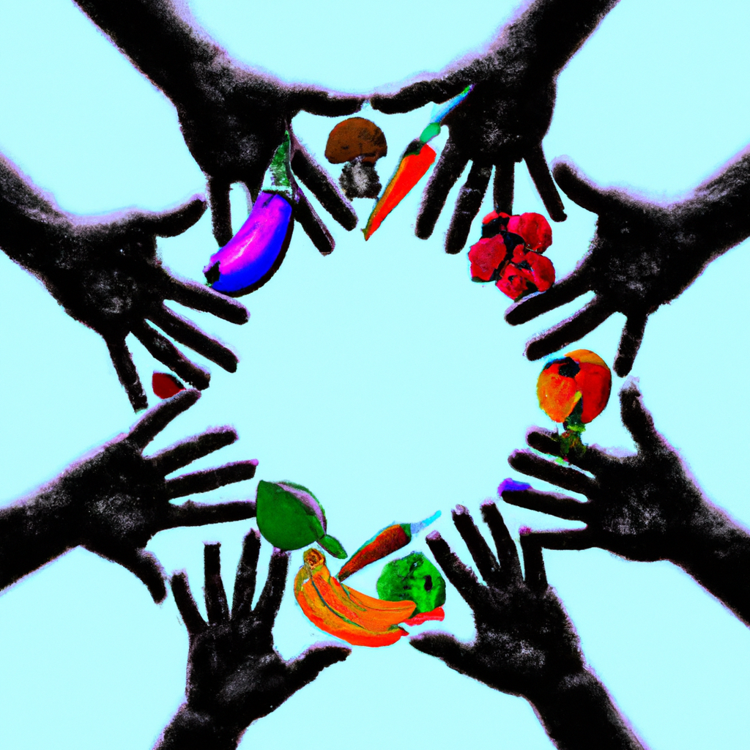
The Impact of Food Wastage (WHY?)
Food wastage has a significant environmental, economic and social impact.
On the environmental side, food wastage leads to increased greenhouse gas emissions, water and energy consumption, and land use.
On the economic side, it is estimated that the global economic cost of food wastage is $940 billion per year. (3)
On the social side, It contributes to hunger and poverty, as well as inequitable access to food, especially in developing countries.
It also exacerbates food insecurity, which is the inability to access enough food to lead a healthy and active life.

Slide 9
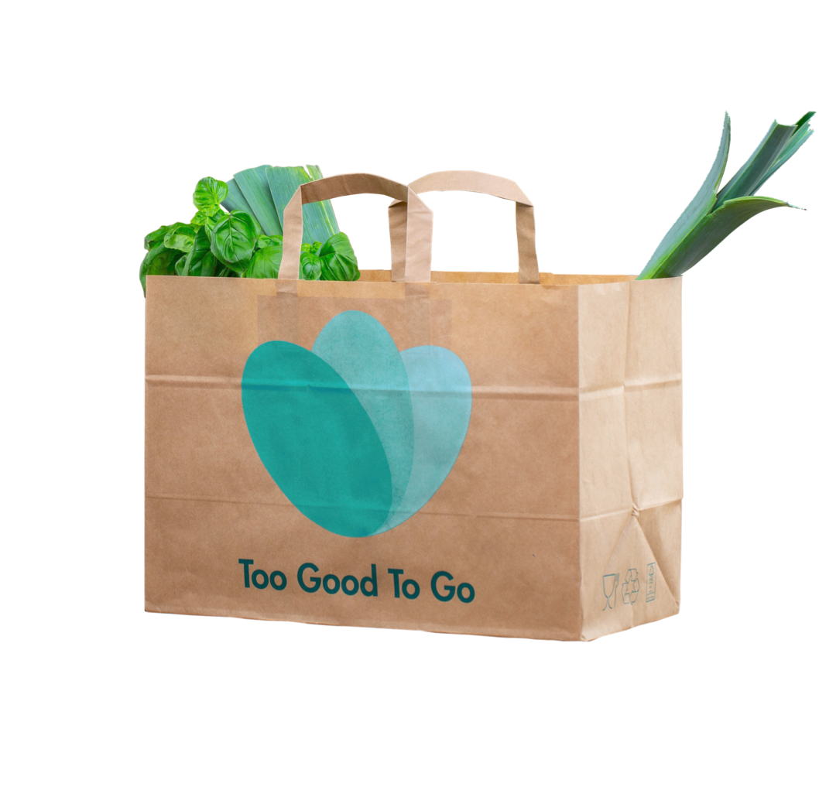
Previous Solutions
Too Good To Go
They make sure good food gets eaten, not wasted as every day, fresh food goes to waste at cafés, restaurants, hotels, shops and manufacturers - just because it hasn’t sold in time. The Too Good To Go app lets customers buy and collect Surprise Bags of food - at a great price - directly from businesses.

Slide 10
Too Good To Go
Us
Middleware between Restaurants and users. Service is for a fraction of the original retail cost. Users can then browse the map for food near them and pick up a ‘magic bag’
Middleware between NGOs and Restaurants, hotels ,etc.. Service is free NGOs request specific food from the available food.

Slide 11
03
Project specifications

Slide 12
Functional Requirements

Slide 13
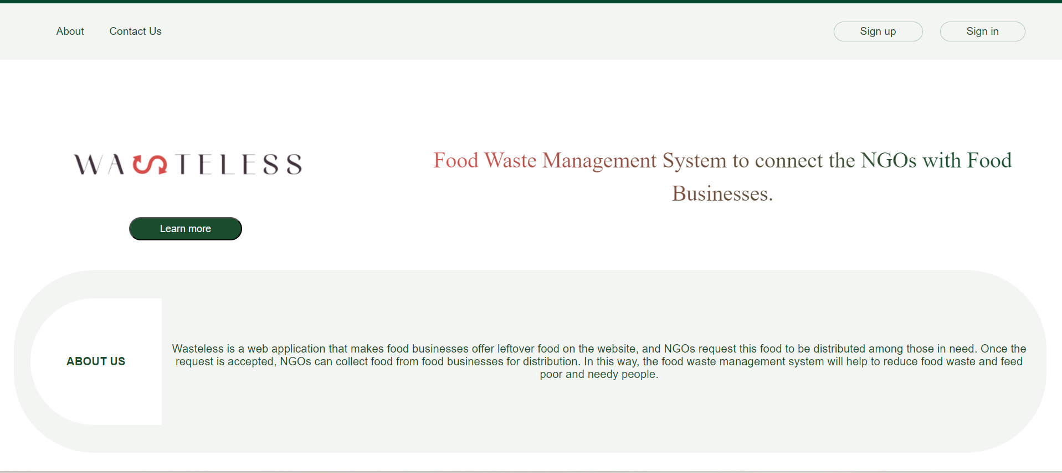
Home page
Contact US
Sign Up
About us page
Sign In
Terms and conditions page

Slide 14
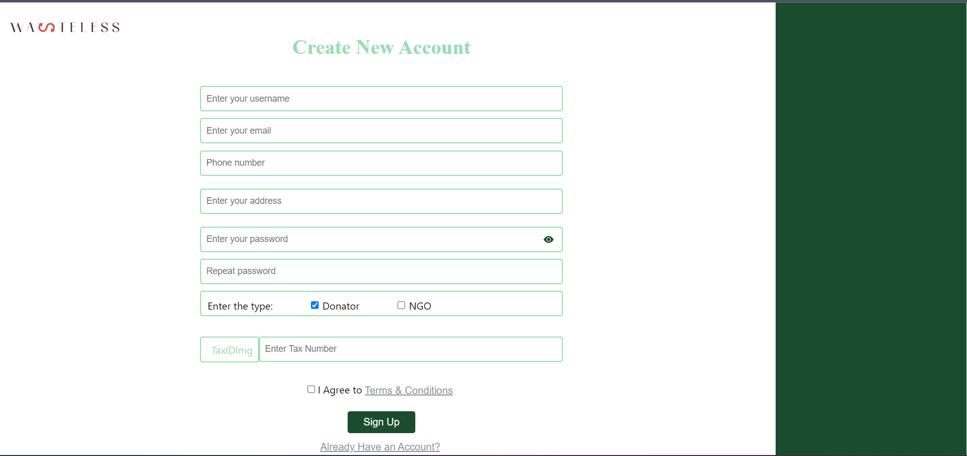
Sign up page

Slide 15
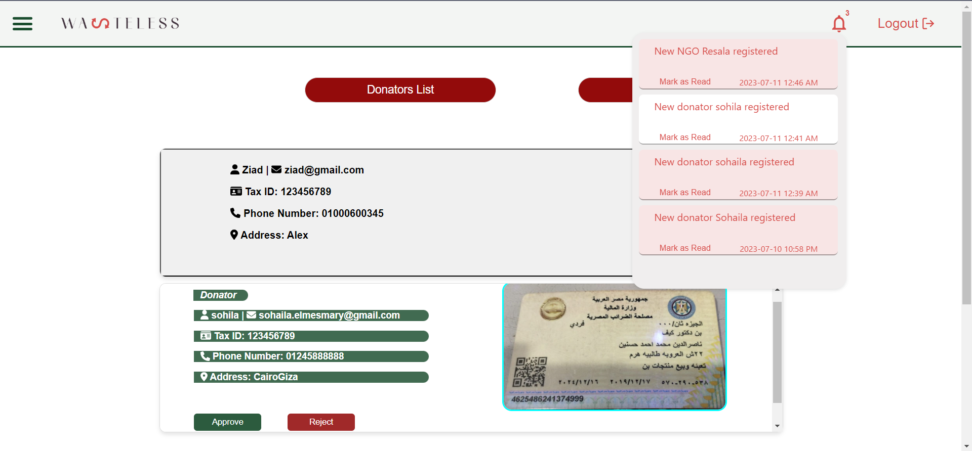



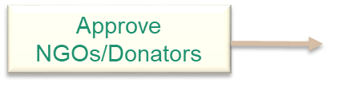
Admin Dashboard Page
View notification
Logout
Reject NGO/Donators

Slide 16
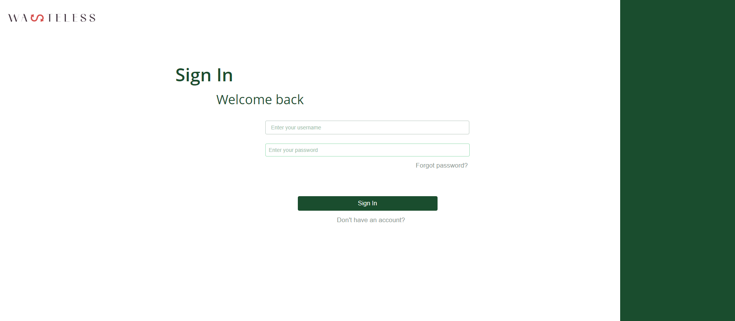
Sign in page

Slide 17
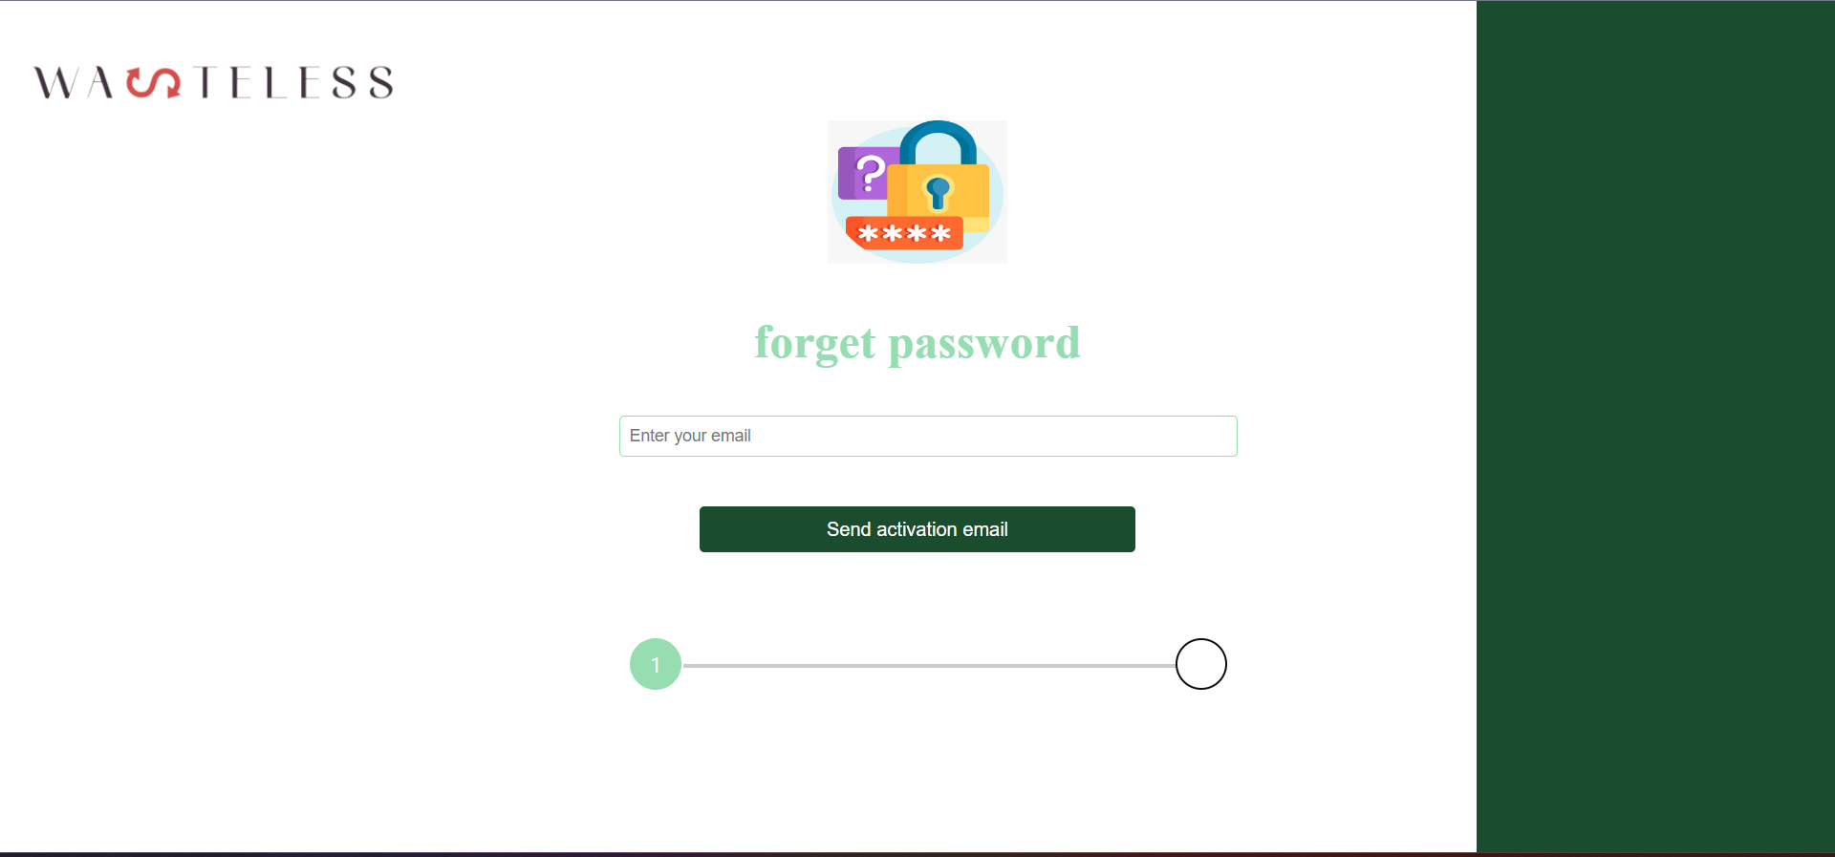
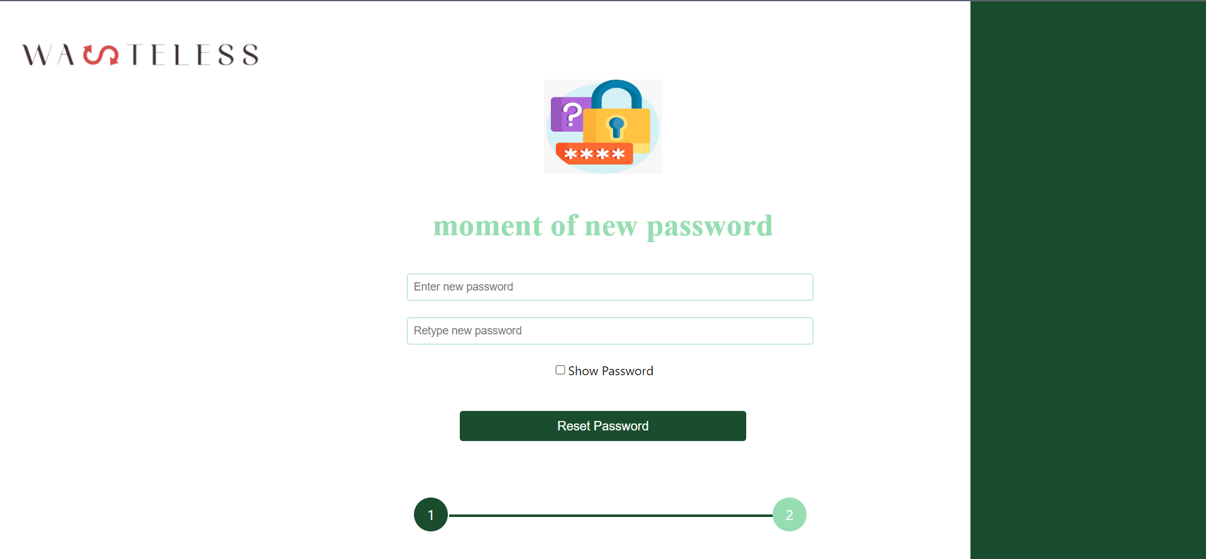
Forget Password page

Slide 18
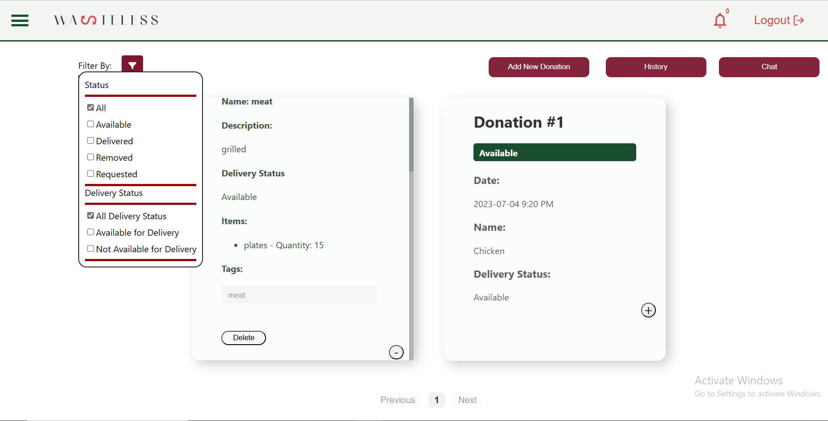
Donator Home Page
Create new Donation Post
logout
View notifications
Filter
View history
Chat with requestor NGO
Remove specific donation post
Expand donation post
Collapse donation post

Slide 19
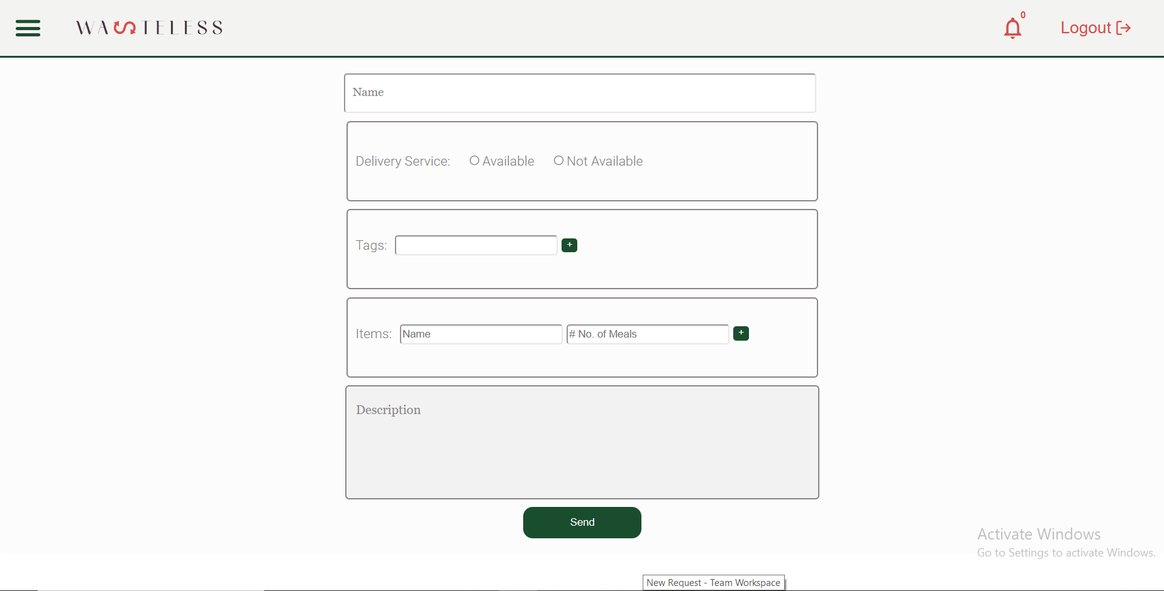
Create Donation Post Page

Slide 20
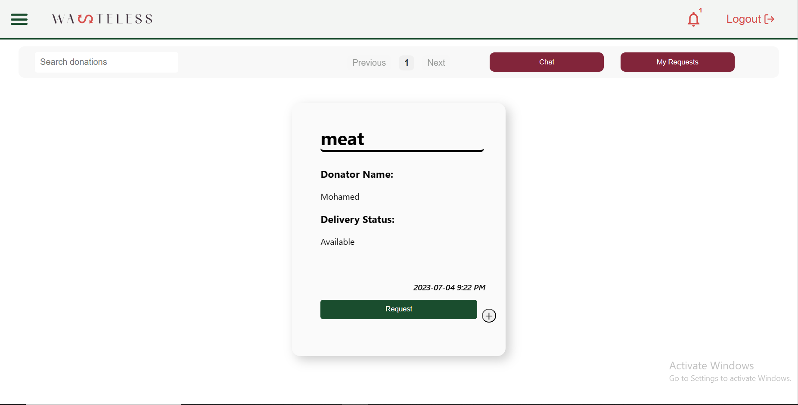
NGO Home page
View notifications
logout
Searching using the donation tags
Chat with donator about the requested donation
Request this donation
Expand the donation to show all details

Slide 21
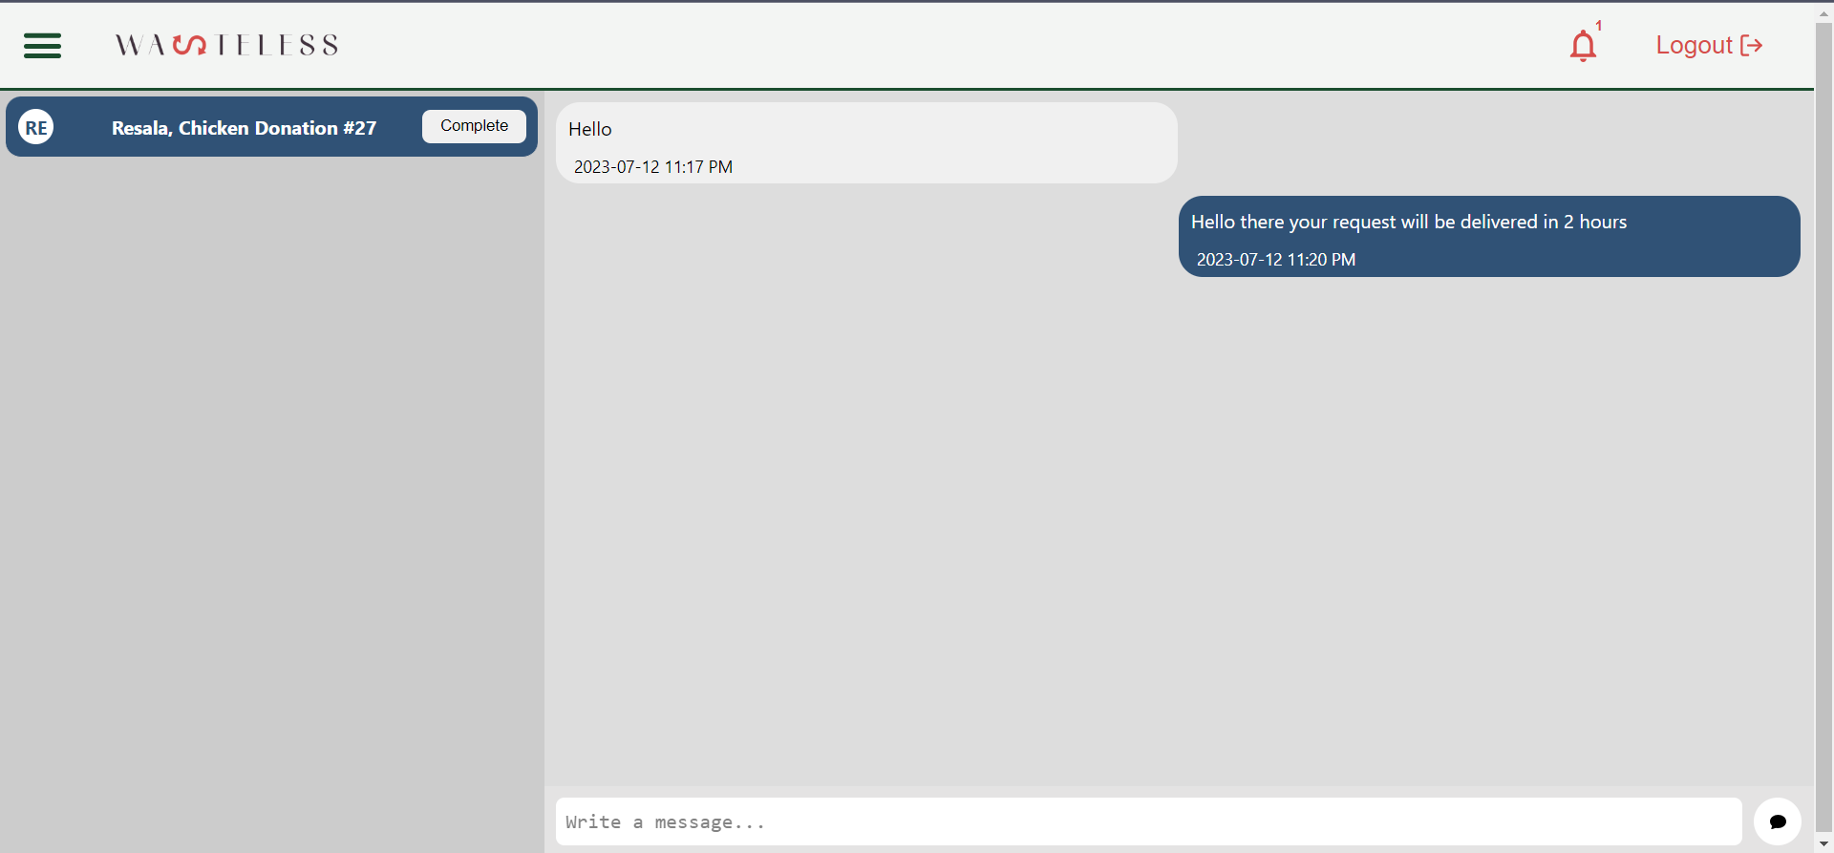
Chat page of Donator
Complete and close Donation

Slide 22
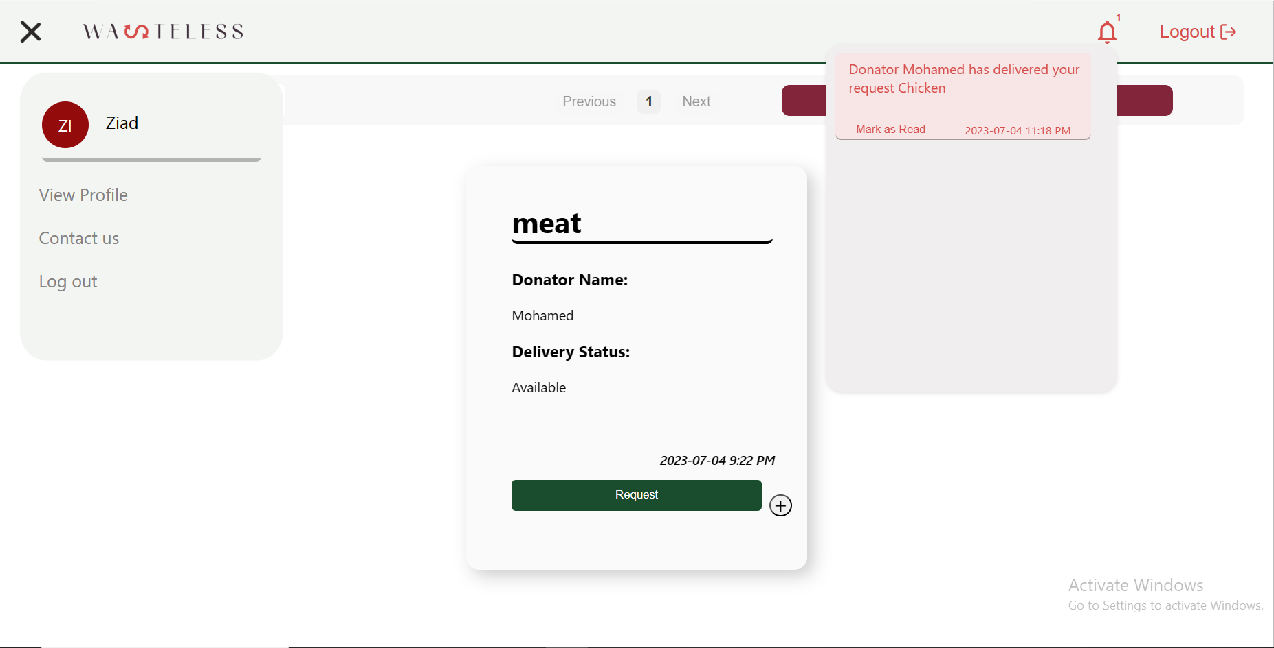
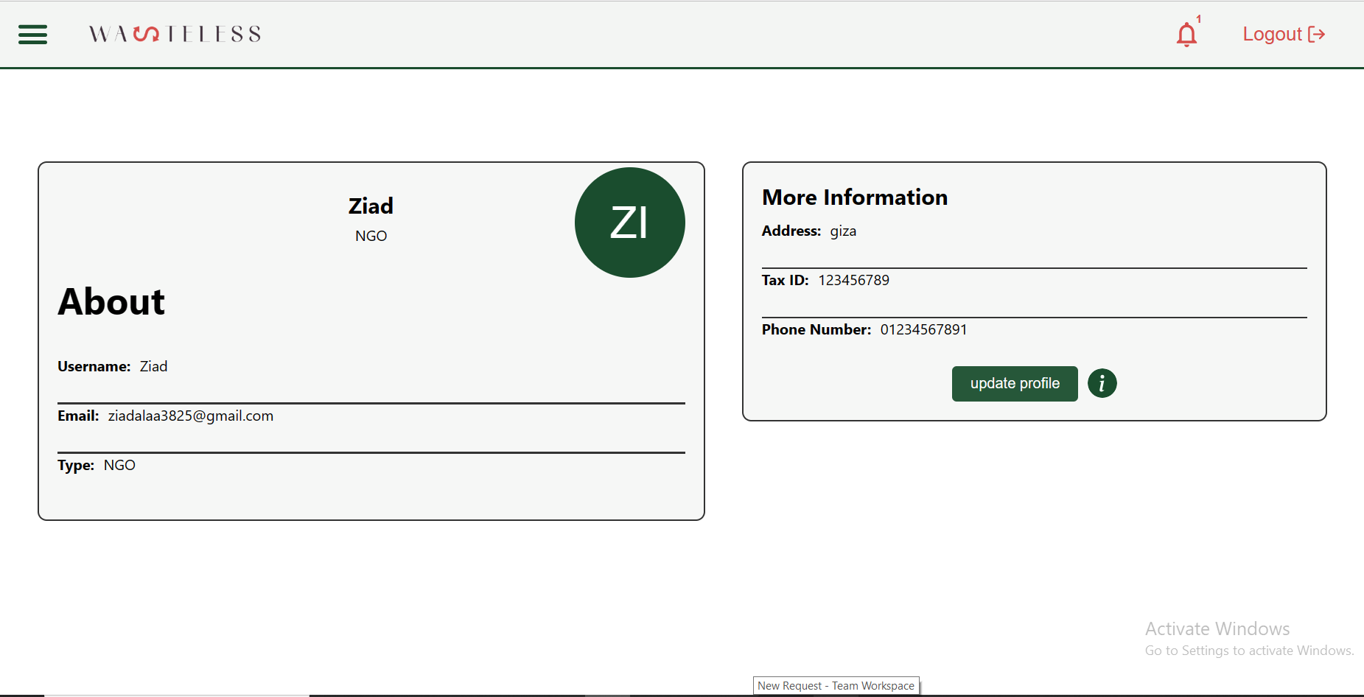
View Profile Page

Slide 23
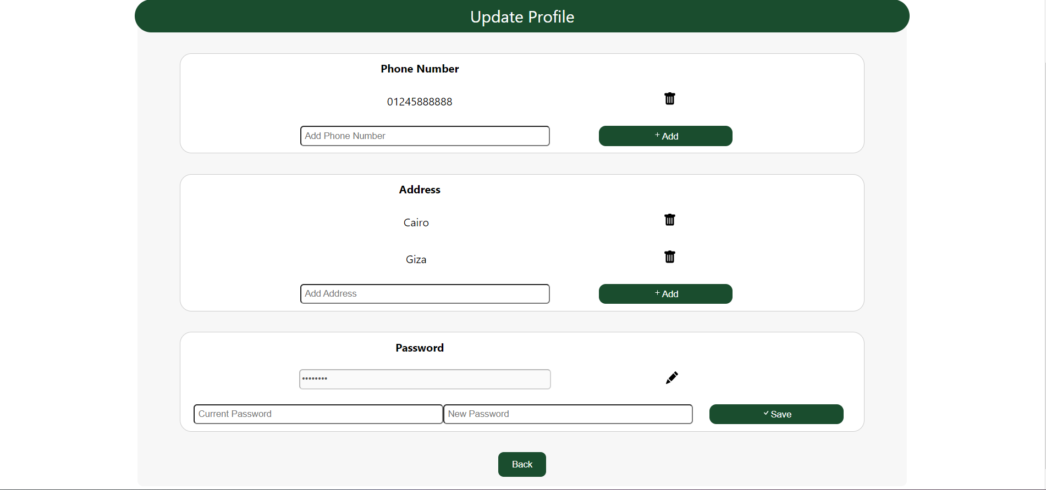
Update Profile Page
Delete phone number
Add new phone number
Delete address
Add new address
Reset Password

Slide 24
Non-Functional Requirements
1.Portability
2. Usability
3. Security
4. Authorization

Slide 25
Stakeholders
External stakeholder
Customers
Donators : Hotels ,restaurants ,shops … etc.
Organizations
Internal stakeholders
Project team(students)
Project Manager (supervisor)

Slide 26
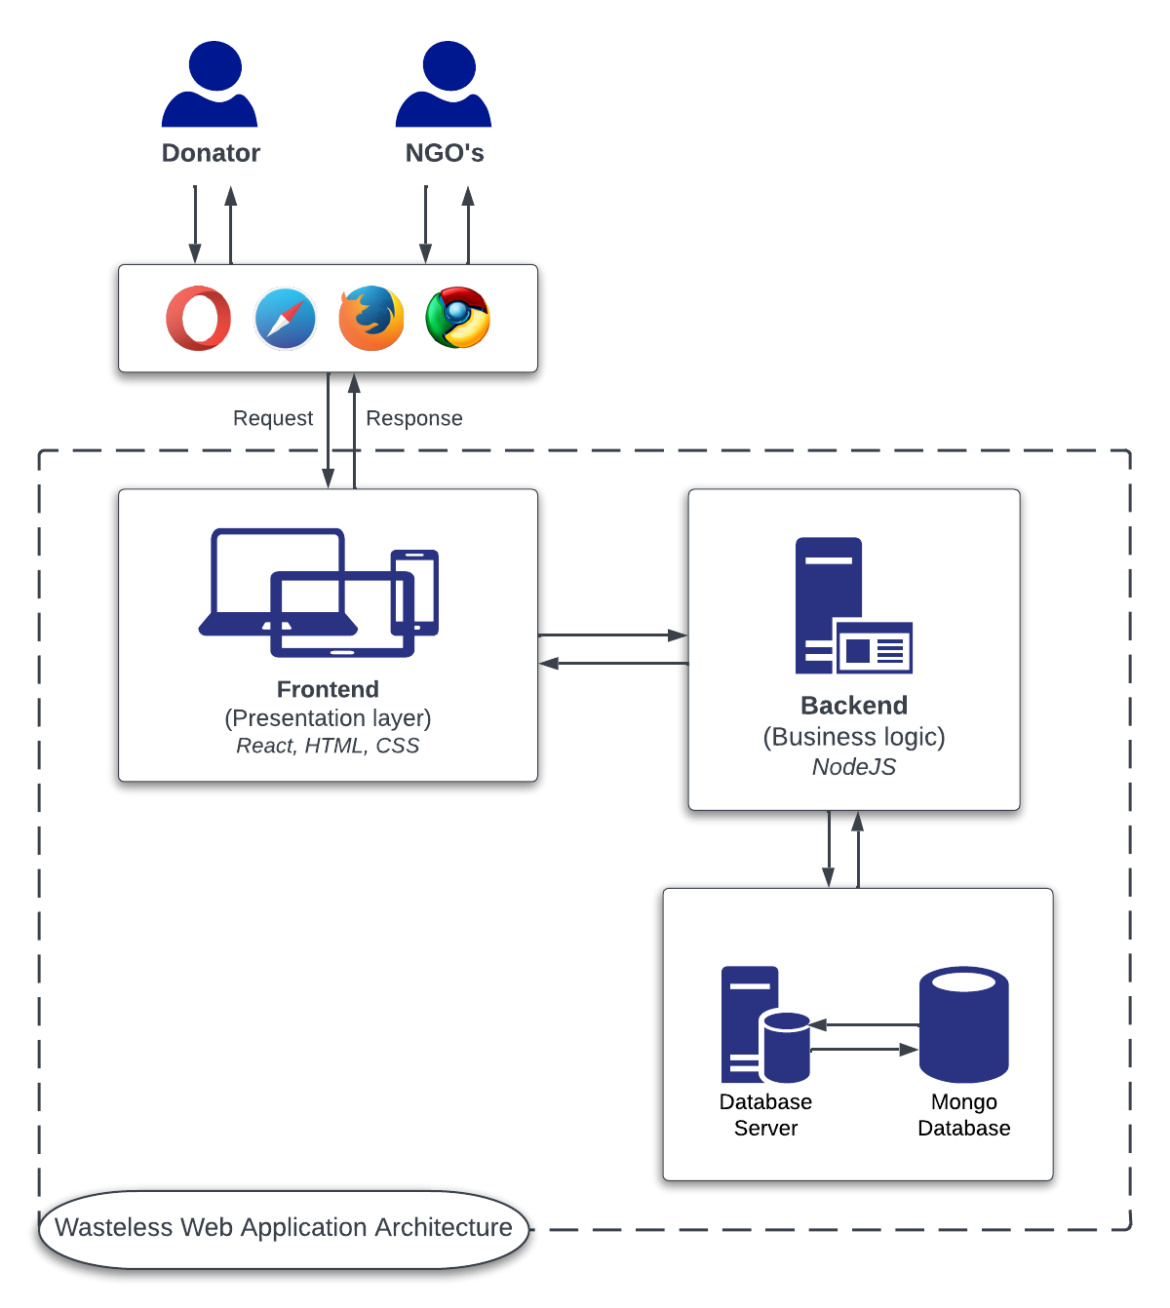

Slide 27
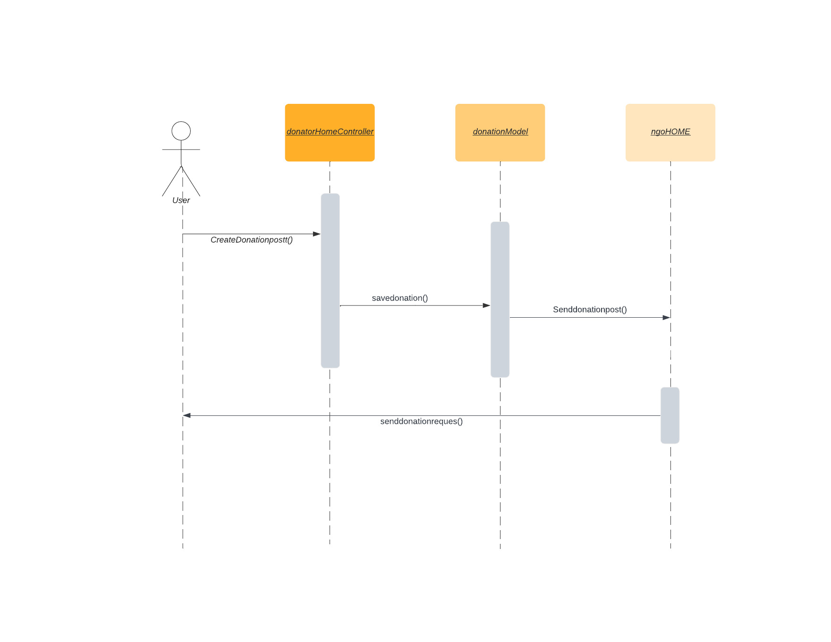
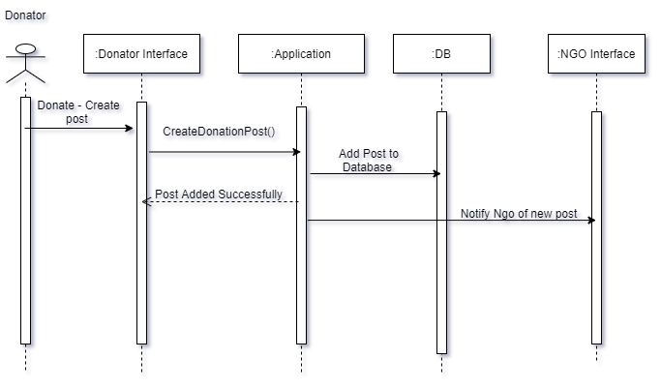

Slide 28
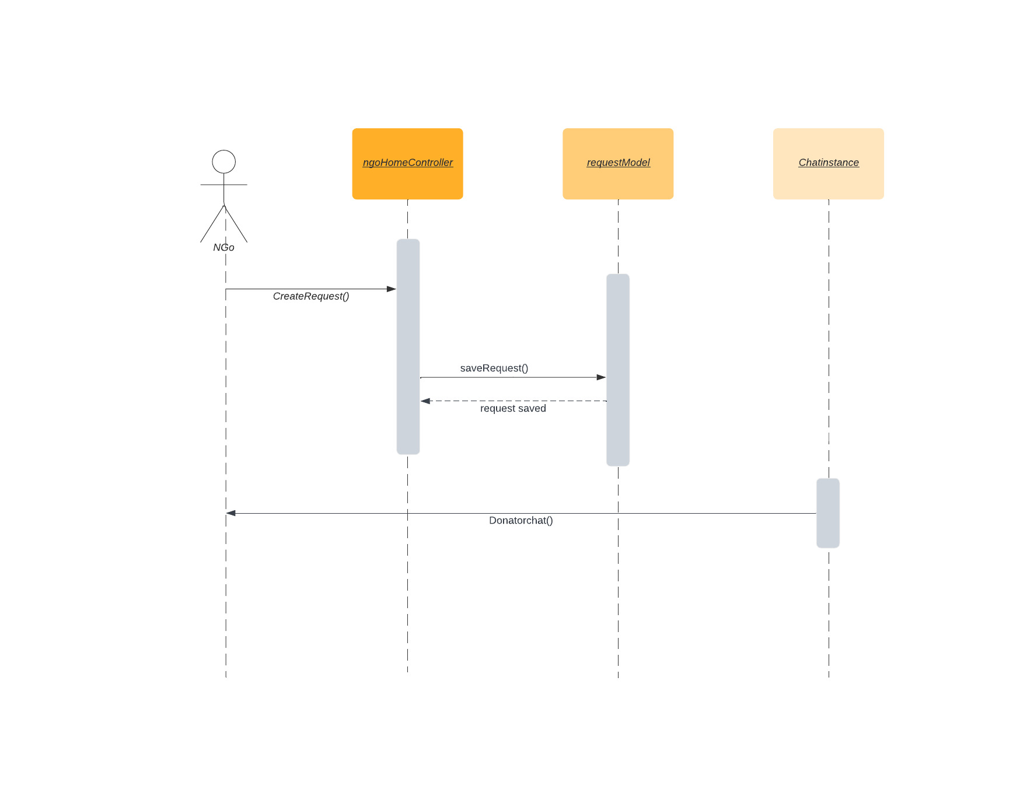

Slide 29
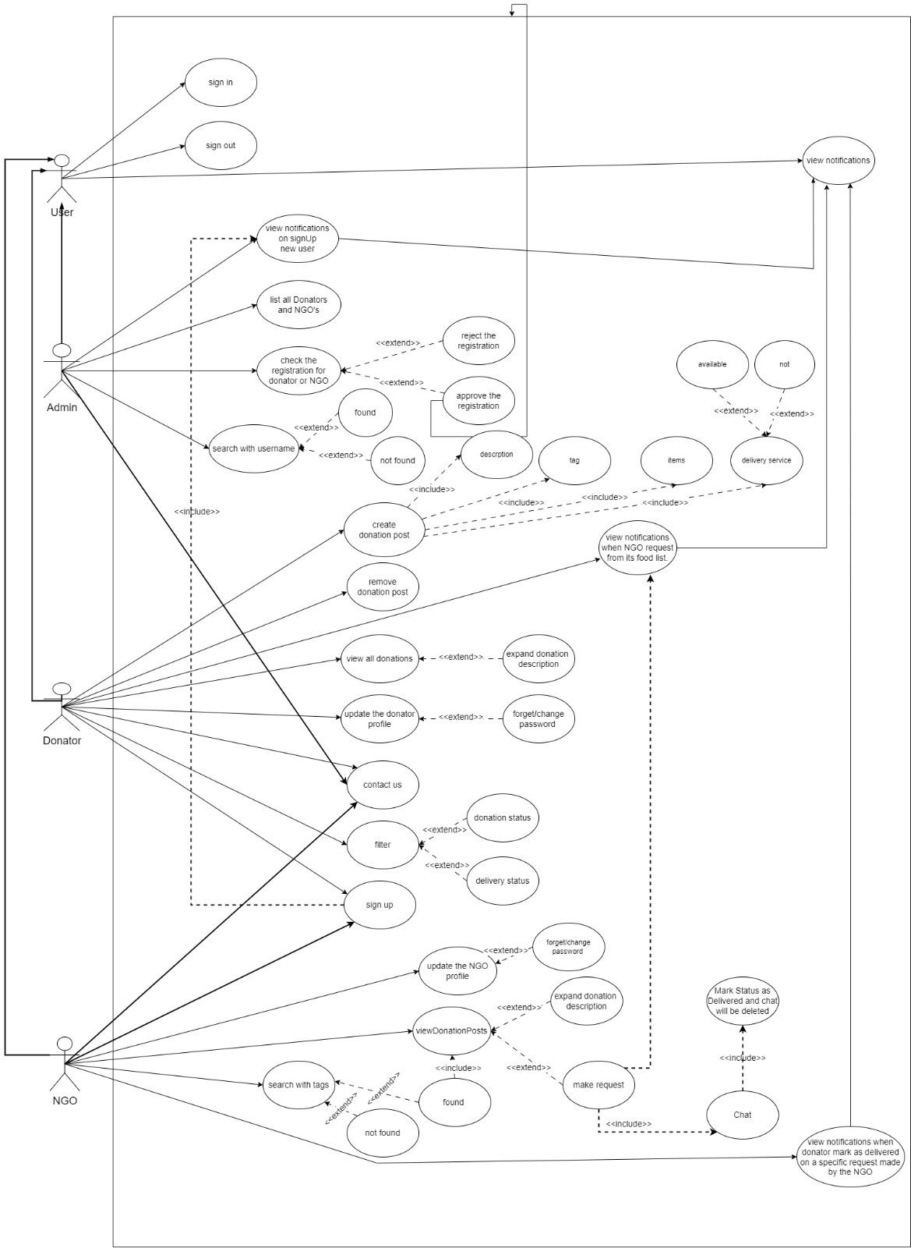

Slide 30
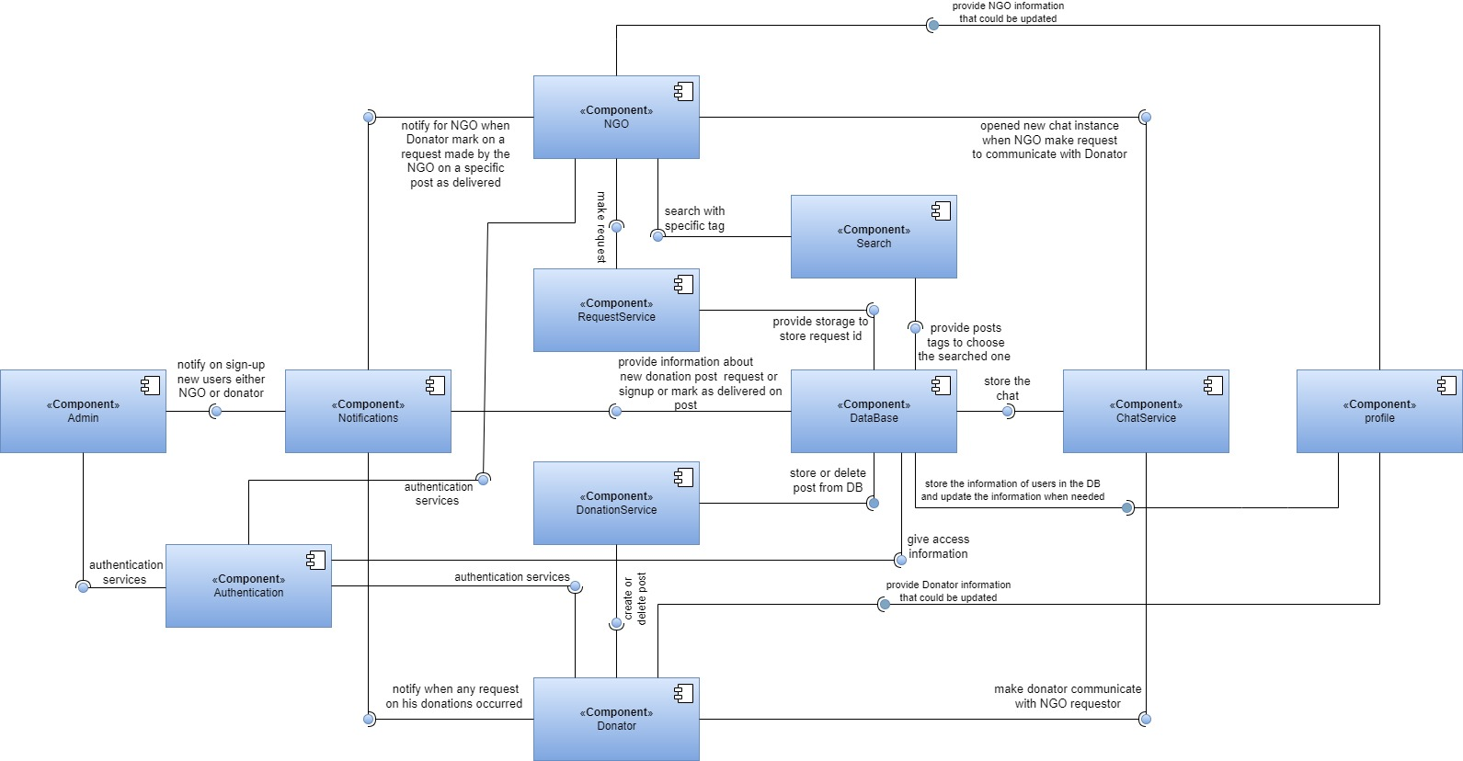

Slide 31
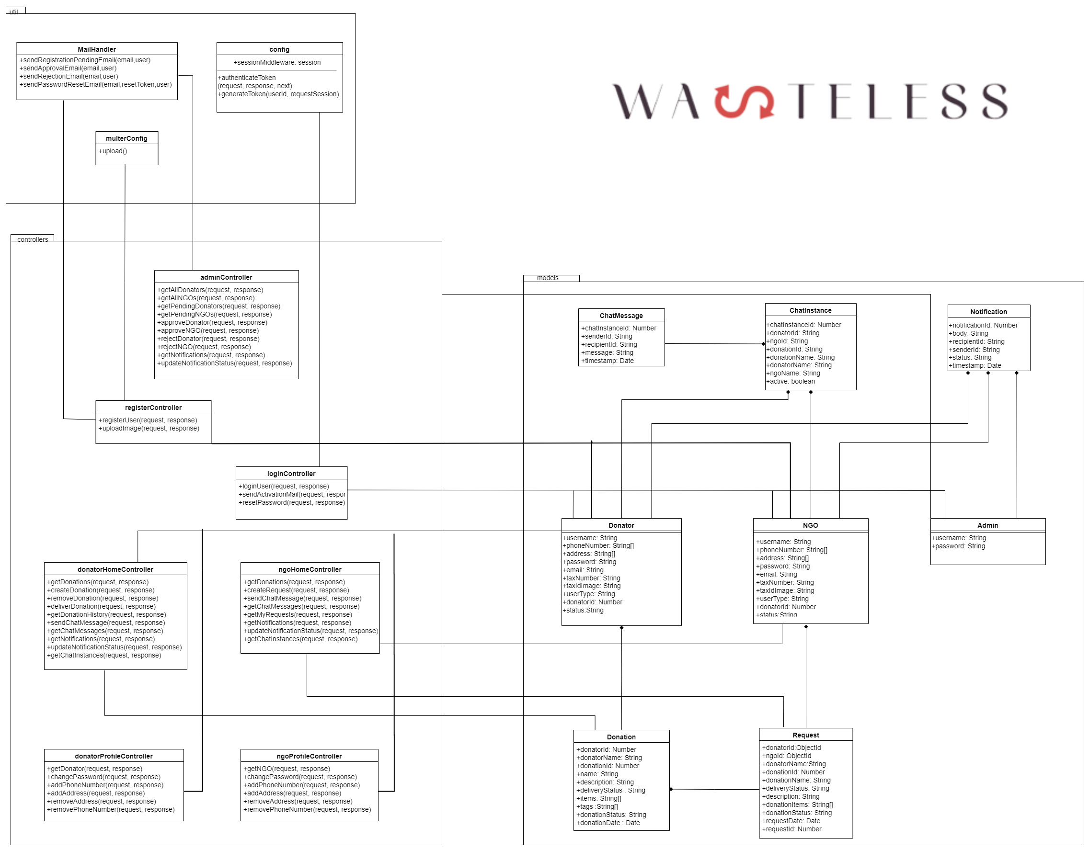

Slide 32
04
Time Plan

Slide 33
Tasks fulfilled in previous 4 months
MAR
MAY
JUN
Continued Implementing
Documentation change , Testing and verification.
Started Implementing
Started learning new technologies
APR

Slide 34
05
Conclusion

Slide 35
Conclusion
Food wastage is a global issue with significant environmental and economic impacts. Reducing food wastage is an important part of creating a more sustainable food system, and has several benefits, including reduced greenhouse gas emissions, improved food security, and improved public health.
Wasteless application can help in reducing food waste by connecting the donators (hotels, restaurants, shops, etc..) with the NGOs that would distribute this food to the needy.

Slide 36
References
1-https://www.ucdavis.edu/food/news/why-is-one-third-our-food-wasted-worldwide
2-https://www.wfp.org/fight-famine
3-https://www.epa.gov/international-cooperation/international-efforts-wasted-food-recovery

Slide 37
Thanks
Do you have any questions?

